Slide 1
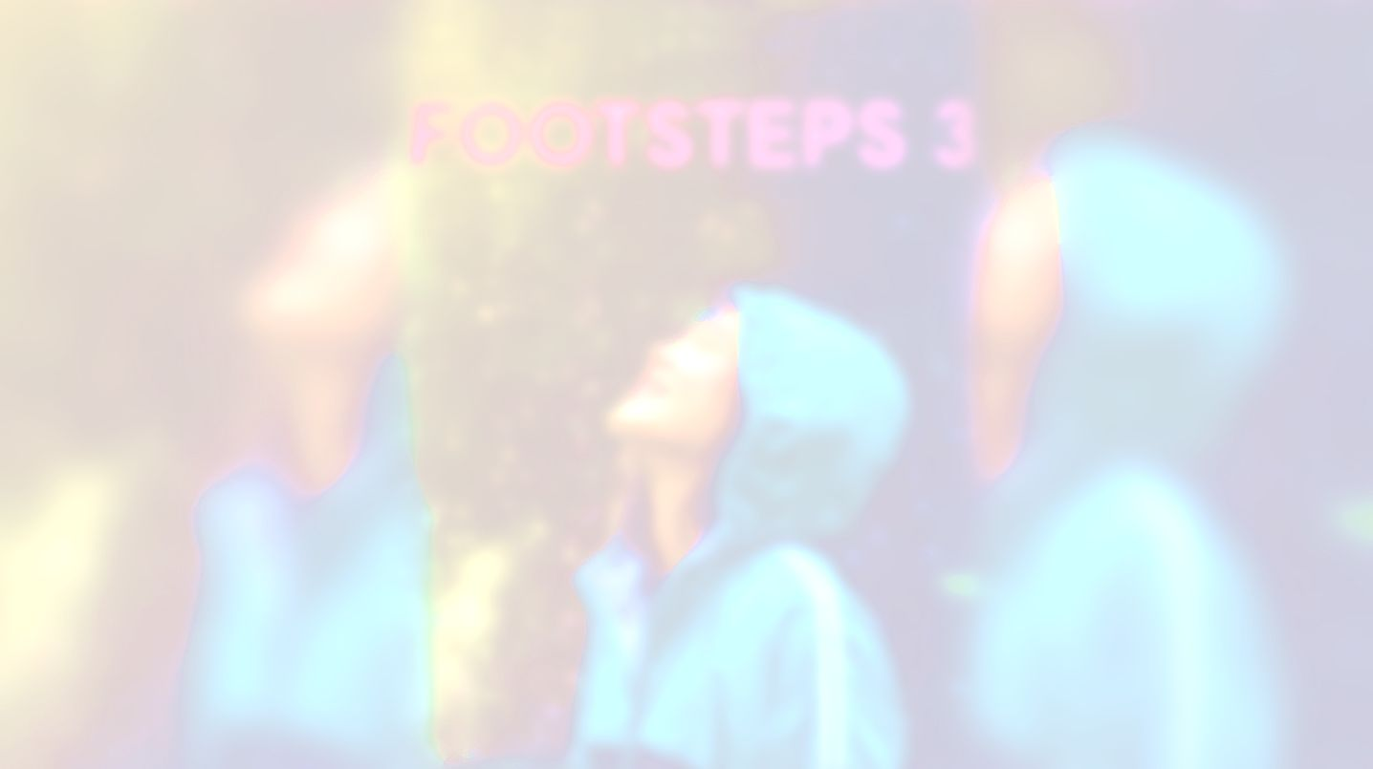
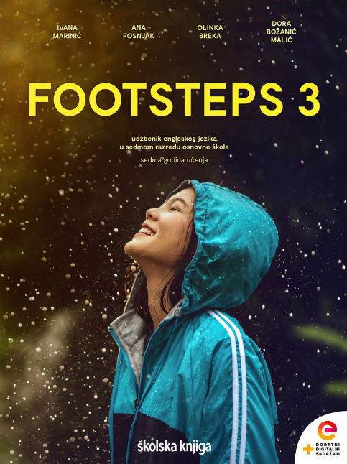

UNIT 4;
Earth Matters
Self-check 4

Slide 2
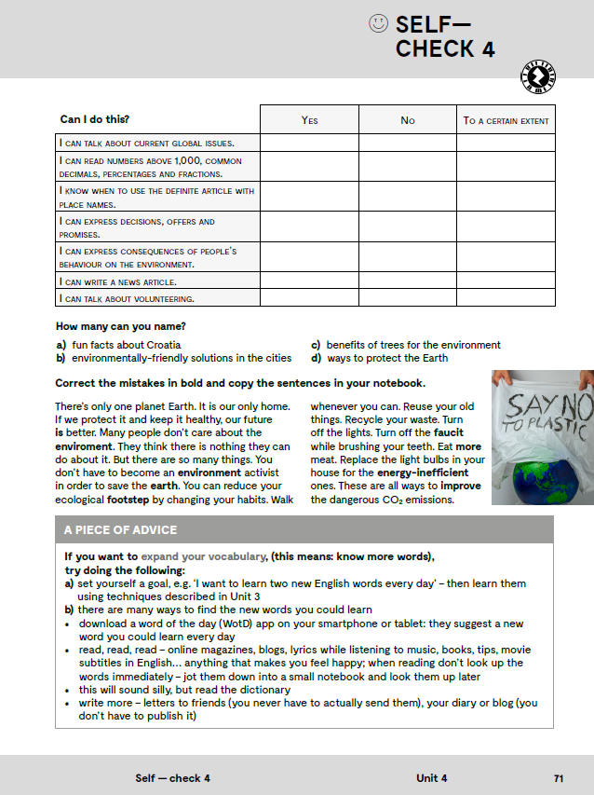
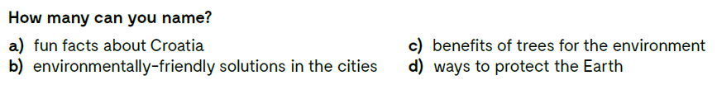

Slide 3
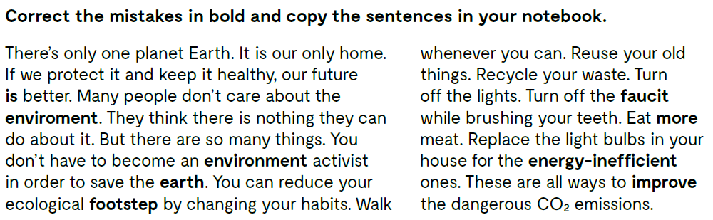
There’s only one planet Earth. It is our only home. If we protect it and keep it healthy, our future is better. Many people don’t care about the environment.
- riječ je pogrešno napisana, tj. nedostaje slovo!

Slide 4
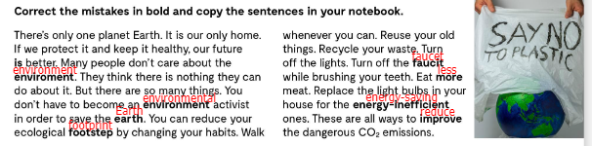
Let’s check!

Slide 5
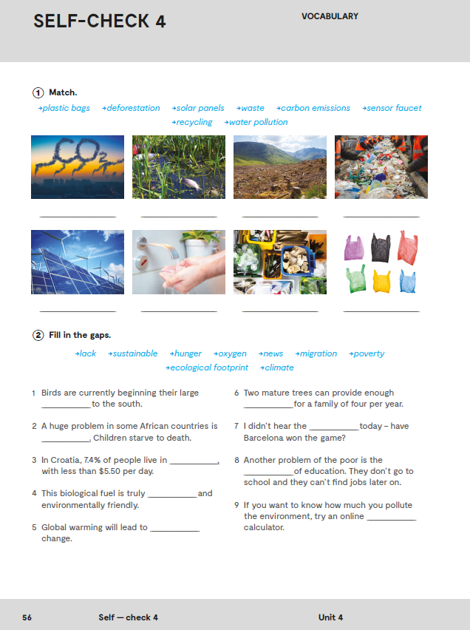
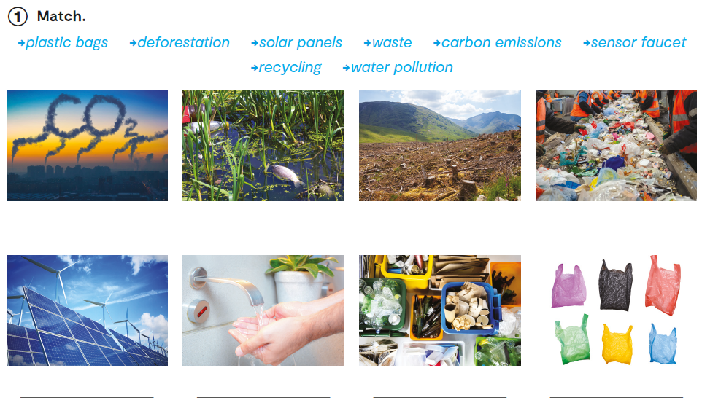
Workbook, p. 56
carbon emissions
water pollution
deforestation
waste
solar panels
sensor faucet
recycling
plastic bags

Slide 6
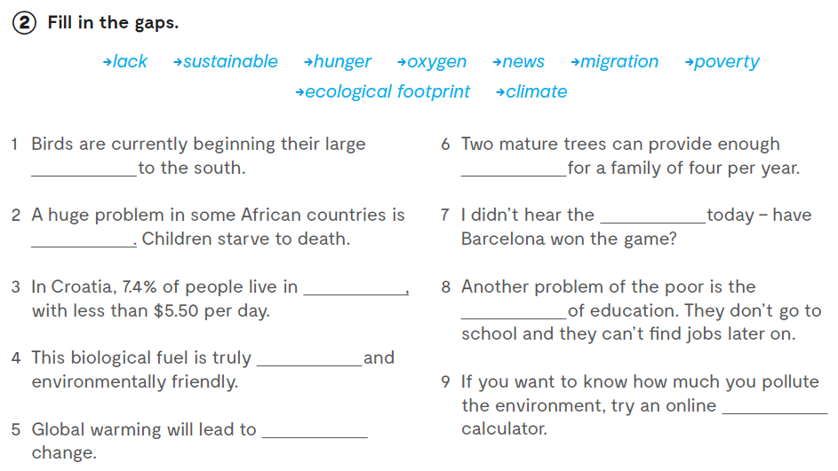
Workbook, p. 56
migration
oxygen
news
hunger
lack
poverty
sustainable
ecological footprint
climate

Slide 7
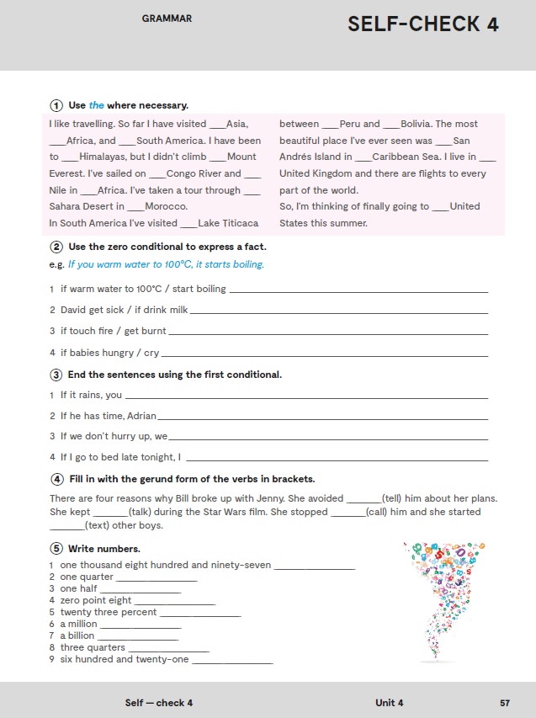
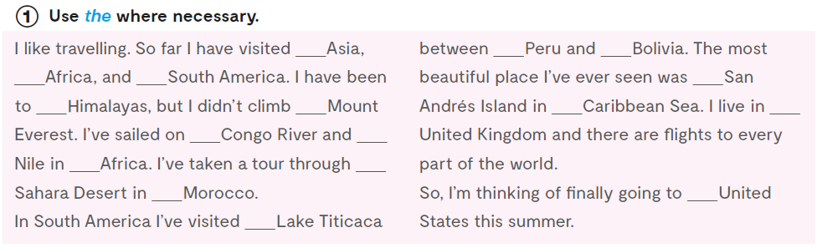
-
-
-
-
-
-
the
-
the
the
the
the
-
the
-
the
-
Let’s practise:
https://wordwall.net/play/885/711/480

Slide 8
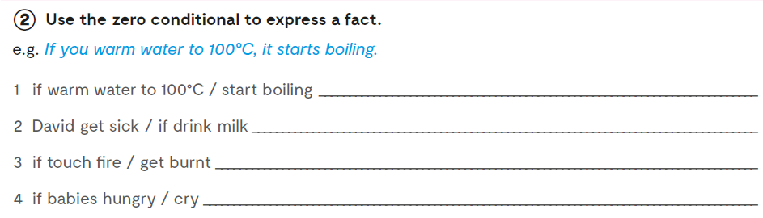
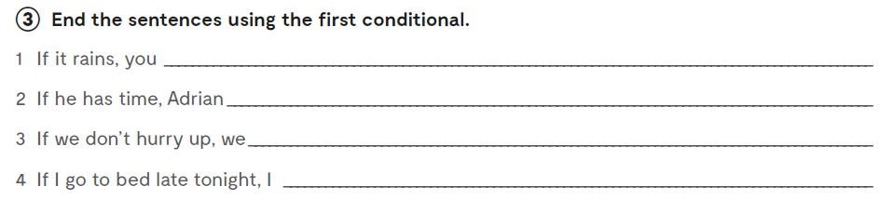
David gets sick if he drinks milk.
If you touch fire, you get burnt.
If babies are hungry, they cry.
will stay at home.

Slide 9
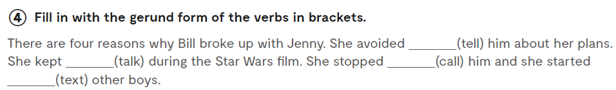
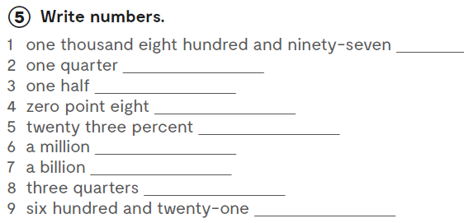
telling
talking
calling
texting
1,897
¼
½
0.8
23%
1,000,000
1,000,000,000
¾
621

Slide 10
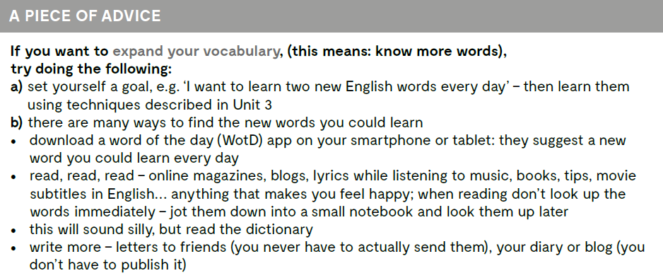

Slide 11
